Slide 1
Manufacturing
Empowering Business with Datahub
Jan, 2022
Notes:
Jahed

Slide 2
-How did ProServe put wheels into motion to drive platform adoption among management & employees? -How did we setup a project team to ensure customer was able to take ownership of the solution?
Context
Technical Deep Dive
How we gained adoption
Outcomes
Lessons Learned
Outro / questions
Today’s Topics
Notes:
Jahed

Slide 3
Context
Notes:
Jahed

Slide 4
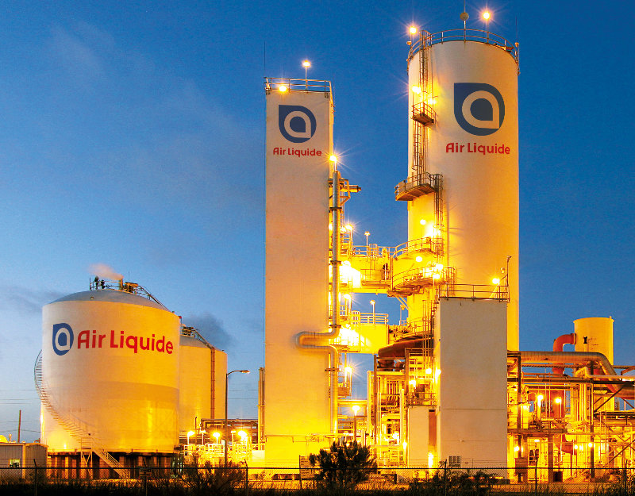
Manufacturing at a glance
Industrial Gases manufacturer & supplier
Oxygen, nitrogen, hydrogen, etc.
Global footprint
80+ countries
3.8+ million customers & patients
Healthcare, Food, Pharma, Petrochemicals, etc.
Notes:
Jahed

Slide 5
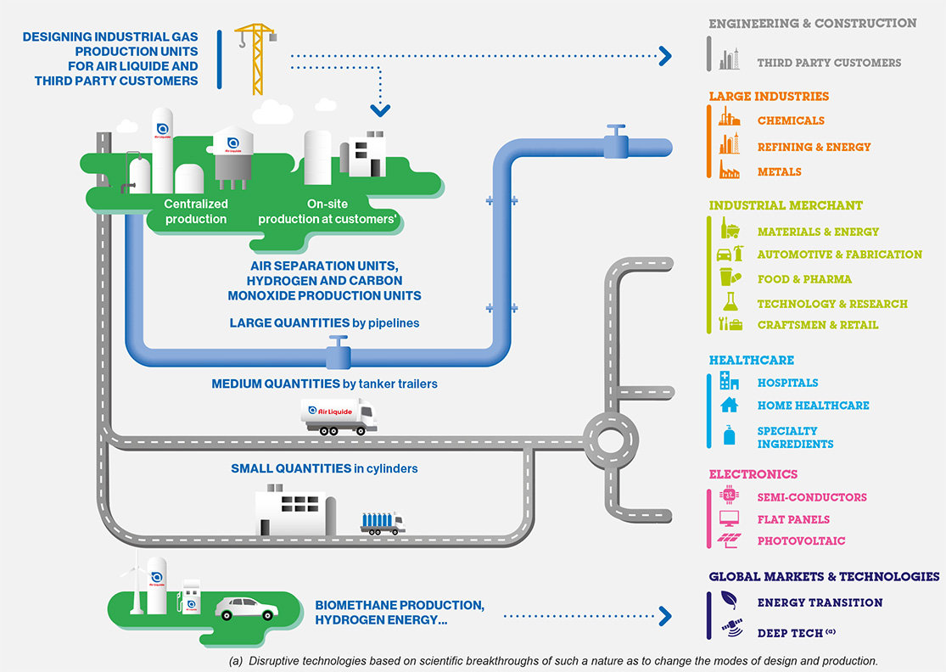
Notes:
Jahed

Slide 6
Manufacturing GDO (Global Data Operations)
Ambition
Data Factory & Global Data Operations
Challenges
Enable industrial innovation through bringing valuable insights
Facilitate decision-making and incidents anticipations to improve performance in supplying industrial gases to customers.
Built a datalake in 2 years to centralize Manufacturing data
implemented a wide range of dedicated programs to implement valuable usecases
Scale and leverage large amounts of data
Access data and insights for Business units, data scientists and data analysts
Notes:
Jahed

Slide 7
Customer Pain points: Journey towards Monetization
- Storing Data at scale & at lower cost
Allowing data access & consumption at scale (2020 - Now)
Data Monetization (future)
Notes:
Jahed

Slide 8
Customer Pain points: Journey towards Monetization
- Storing Data at scale & at lower cost (Data Lake, 2018)
Allowing data access & consumption at scale (2020 - Now)
Data Monetization (future)
Notes:
Jahed

Slide 9

Customer Pain points: Journey towards Monetization
- Storing Data at scale & at lower cost (Data Lake, 2018)
Allowing data access & consumption at scale (2020 - Now)
Data Monetization (future)
Notes:
Jahed

Slide 10
Customer Pain points: Journey towards Monetization
- Storing Data at scale & at lower cost (Data Lake, 2018)
Allowing data access & consumption at scale (2020 - Now)
Data Monetization (future)
High untapped potential in Data, Machine Learning & IoT
Growth potential on various segments (Hydrogen 📈)
But: Pressure from Management since Data Lake brings no ROI
Notes:
Jahed
Besoin de donner accès aux équipes métiers (DS/DA/BA) à ce data lake.

Slide 11
Customer Pain points: Journey towards Monetization
Allowing data access & consumption at scale (2020 - Now)
How do we scale our governance model for data access & ownership?
How can we discover data cross-BU & cross-geo?
How do we lift the burden off of our data engineering team?
Which tool can we help democratize data projects in all BUs ?
➔ How do we reduce time-to-productivity for future data-driven projects?
Notes:
Jahed business owners to become data owners

Slide 12
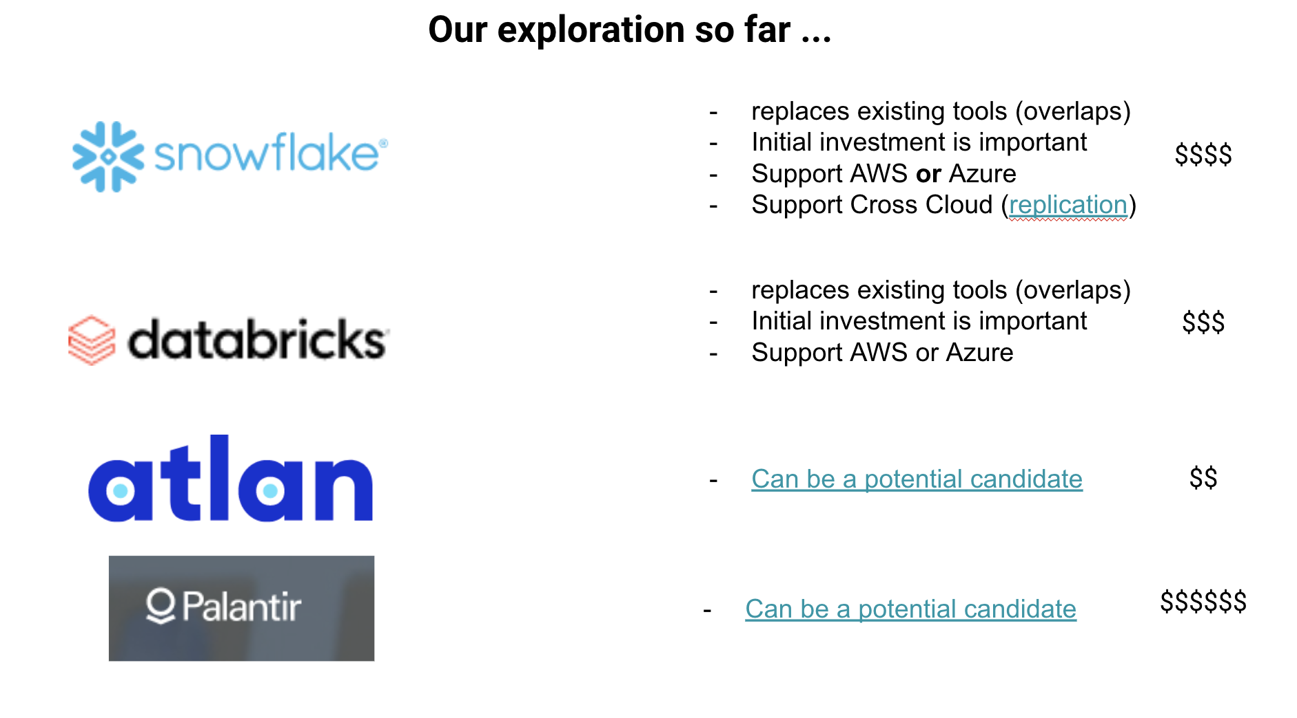
Notes:
Jahed

Slide 13
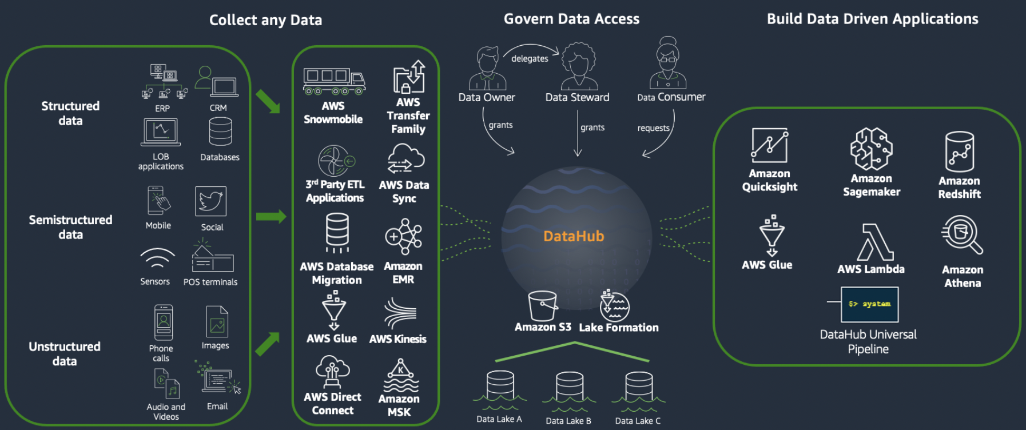
Enters Datahub (December 2020)
- Manufacturing to be able to host & manage its own data workspace
Notes:
Jahed > Sarra

Slide 14
Technical Deep Dive
Notes:
Sarra

Slide 15
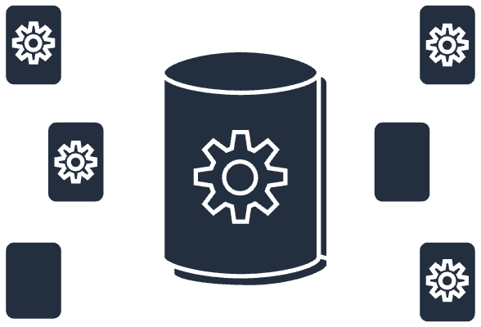



Datahub Unified Solution
Data Discovery
(federated data catalog)
Integrated Analytics
(Dashboards,
Notebooks,
SQL Worksheets)
Data Accessibility
(from AWS APIs
and Services)
Datahub
Built-in Blueprints
(data pipelines)
Infrastructure Automation
(storage, compute, security)
Team collaboration
(data sharing)
Notes:
Sarra + Demo de l’appli

Slide 16
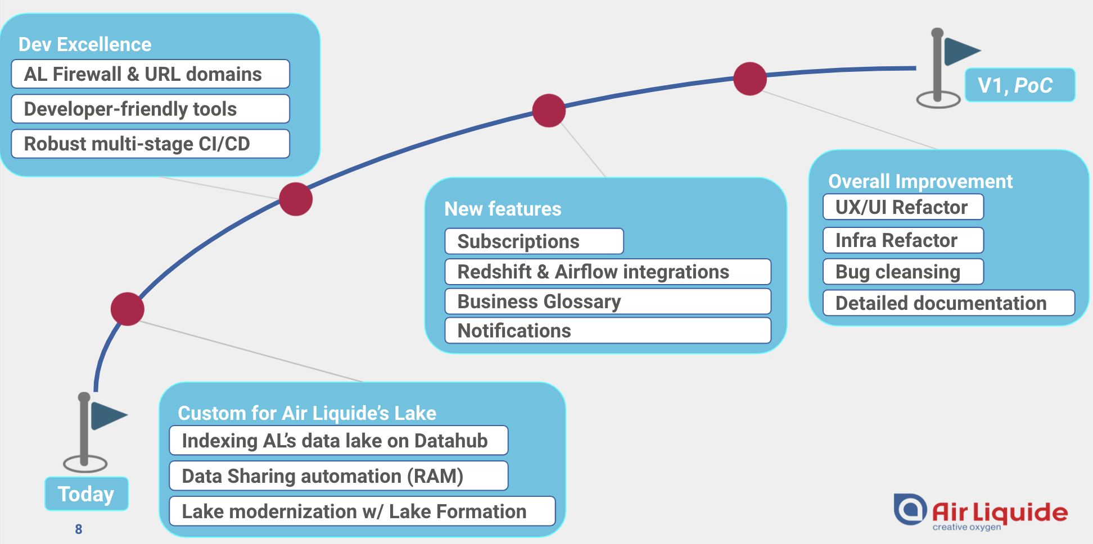

Evolving Datahub with Manufacturing
Notes:
Jahed
Some evolutions we did we
the client, Some we spent time integrating what we (Amine, & others at other customers) spent time integrating). In the end we did a lot of Software/CI/CD

Slide 17
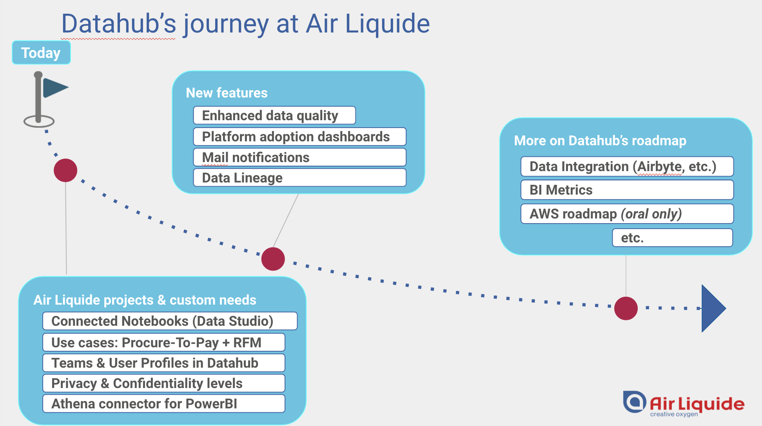

Evolving Datahub with Manufacturing
Notes:
Jahed

Slide 18
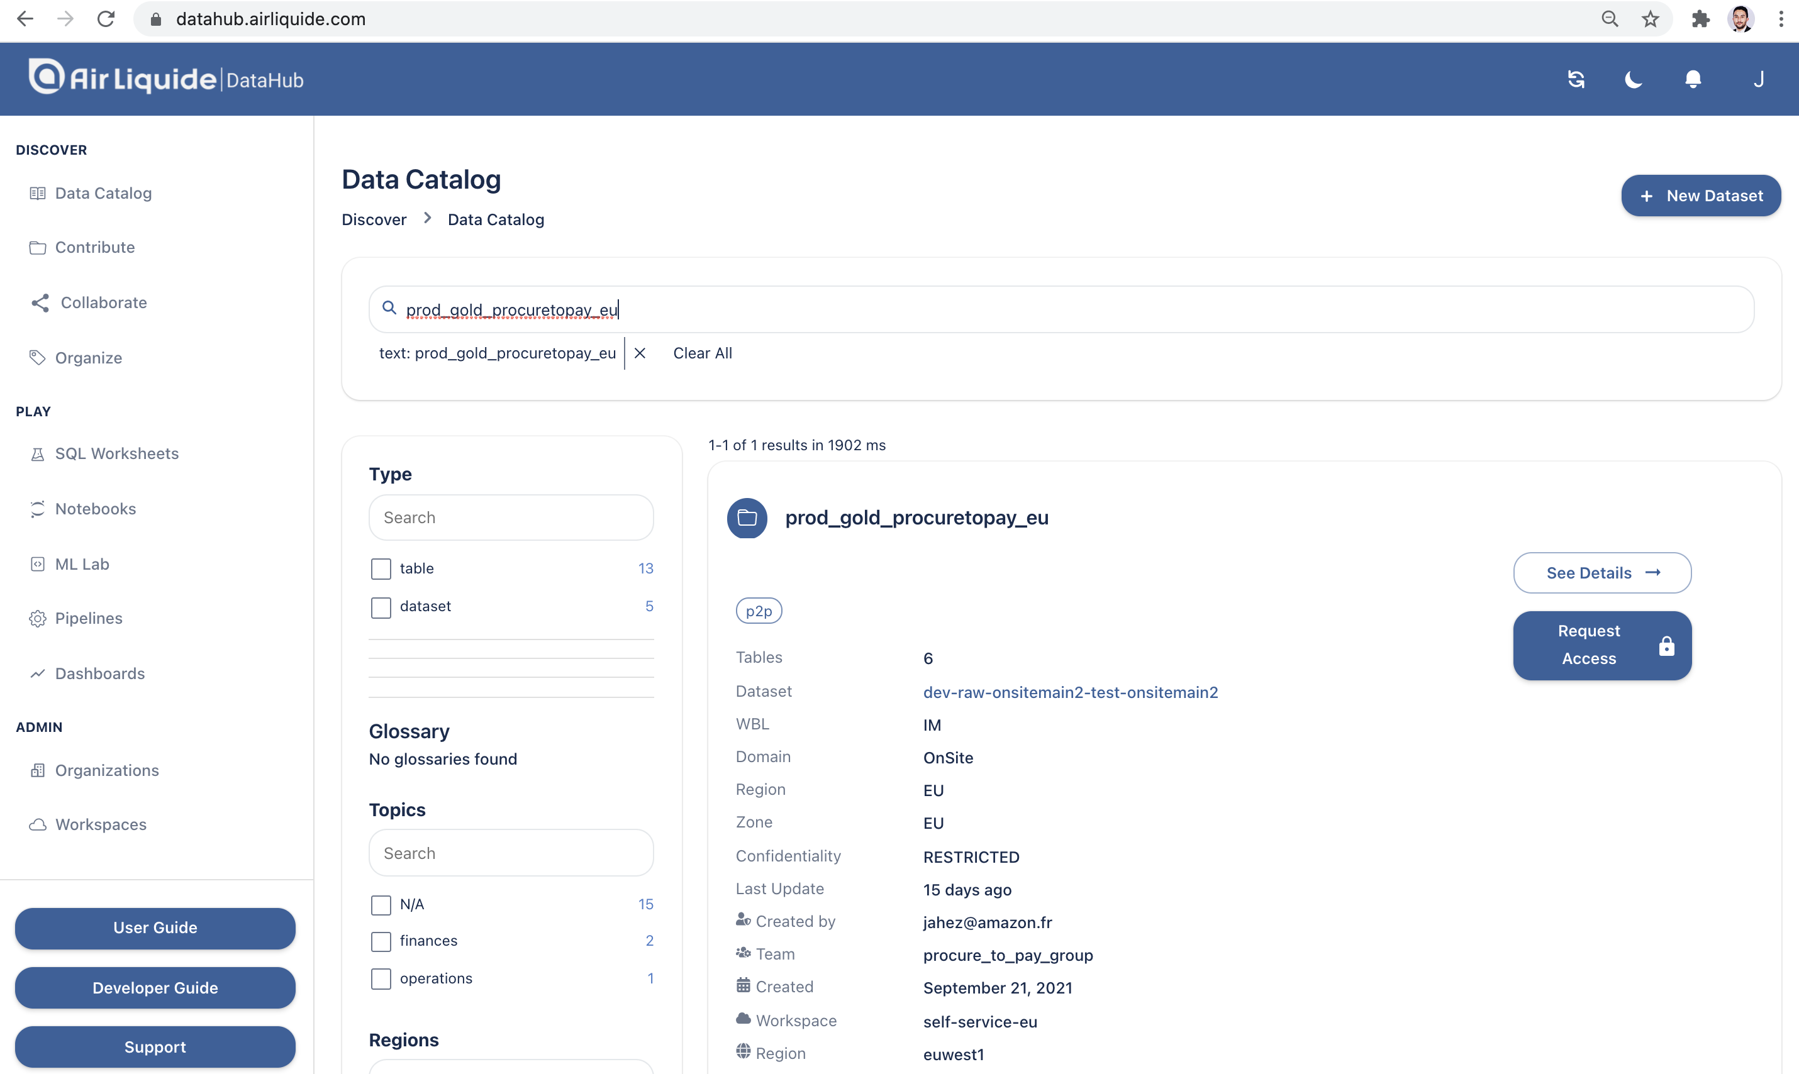
Evolving Datahub with Manufacturing
Notes:
Jahed

Slide 19
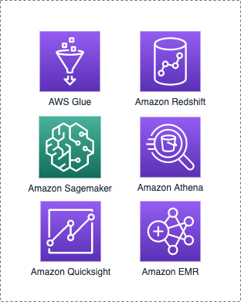




Providing the tools to scale Advisory on Data Lake architecture Support towards Lake formation migration
Request data access
Granular permissions (users/roles)
Users
Lake Formation allow data access
Notes:
Sarra

Slide 20

Demonstrating value close to business stakeholders « Procure-to-Pay » Analytics use case
Europe Industries Audit
Audit of Manufacturing processes to check compliance with AL policies & local regulations
Extraction of Vendors data from ERPs
Preparation of the data through IDEA systems and Microsoft Excel
Identification of changes on data
Sharing data through emails channels
Access to unique data catalog
Data Preparation through datahub pipelines
Query directly data to extract insights and detect changes
Exporting and sharing data between teams
Empower Business with data access and exploration
Notes:
Sarra

Slide 21
Gaining traction & adoption
Multiple streams
Help customer secure all their demos to decision makes (Lake Formation, Data Lake import in Datahub, Teams feature, etc.)
Procure-to-Pay: Get customer to write their own Trip report for internal branding & adoption. Internal audit team was our “beta testers cohort”
PowerBI x Datahub: Helped customer definer their own roadmap
Influenced internal data projects to converge towards datahub. Embarked 2 strategic existing projects (Data Science cohort, Data Portal)
Notes:
Jahed
Lots of pressure, decision silos, snowball effect

Slide 22
Outcomes

Slide 23
Outcomes
Customer Trust
Long term collaboration
Impact
CSAT 10/10
Data & ML roadmap progressivly shared with ProServe
Polished ProServe image within AL (Opportunities discussed for HPC, Security in other BLs, according to practice ESM)
Chapter 1 of our relationship with GDO
Influenced Manufacturing data roadmap (Airbyte+dbt, PowerBI, etc.)
On-going innovation for Datahub: Opportunity discussed (new features + operational assistance)
Larger opportunity discussed: 5-year AI-Readiness program to scale AI/ML across all the global organization.
Wider audience within Manufacturing: Raised awareness, GDO roadshow to BLs. GDO will present project to the CIO
Attempt to have a cultural impact on our team, beyond technical delivery
Datahub adoption by multiple Manufacturing teams (Cohort of 70 cross-BL EMEA Data Scientists in November, R&D teams), Data Portal on Datahub
Notes:
CSAT 10/10 Mars
CSAT X/10 Octobre
Next steps: On-going innovation with Datahub (Support & maintenance + New features: airbyte & dbt)
Influenced Manufacturing data roadmap (airbyte, dbt, PowerBI, etc.)
Larger opportunity discussed: AI-Readiness program, Goal: Scale AI/ML across all the global org. How can AWS be part of this picture? 3/ Data Monetization ===> Later? Use cases cool
Win solution retenue pour le programme AI-readiness + R&D Trainings (+ Soon to be presented to C-levels?)
(Polished ProServe image within AL: SOW HPC, Security with ProServe in other BLs according to ESM)
Reach wider and wider audience within Manufacturing, raised awareness
Chapter 1 of building a long-term relationship with Manufacturing

Slide 24

Lessons Learned
Learnings

Slide 25
Learnings
Anticipation is key
Manage cultural differences
Leverage PFRs & proximity with Service Teams
Retroplanning at best
Be cautious of unreleased AWS services
Slow-paced, non digital-native 120 y/o large group
Weak ownership, absence of an efficient decision-making mechanism, decision silos
Help customer shifting gears, take ownership beyond technical delivery
Customer feels valued for this
Notes:
Ne pas écrire sur le SOW des trucs unreleased. (Data Lineage, promis fin Q2, still waiting)
“Earn Trust” is a journey rather than a milestone
Cultural differences between us and them: Customer pace is slow, Decision making is an unefficient process, C’est à nous de les aider à raise the bar et accélérer. Prendre le projet en main au delà du delivery technique (pour combler leurs lacunes) : roadmap, give the pace, etc.
Try to have an impact wider than technical delivery: cultural shift
100-year old Industry leader vs Digital native leader
Lack of an efficient Decision-making mechanism.
Anticipating workloads as early as possible, even if customer
Savoir ce dont le client à besoin, avant même qu’il sache qu’il en a besoin (AD groups, )

Slide 26
Learnings
ProServe & Solutions Architect collaboration
Earn trust is a journey rather than a milestone
Notes:
Ne pas écrire sur le SOW des trucs unreleased. (Data Lineage, promis fin Q2, still waiting)
“Earn Trust” is a journey rather than a milestone
Cultural differences between us and them: Customer pace is slow, Decision making is an unefficient process, C’est à nous de les aider à raise the bar et accélérer. Prendre le projet en main au delà du delivery technique (pour combler leurs lacunes) : roadmap, give the pace, etc.
Try to have an impact wider than technical delivery: cultural shift
100-year old Industry leader vs Digital native leader
Lack of an efficient Decision-making mechanism.
Anticipating workloads as early as possible, even if customer
Savoir ce dont le client à besoin, avant même qu’il sache qu’il en a besoin (AD groups, )

Slide 27
Looking back at the milestones we crossed, it only makes sense for us to pursue collaboration with AWS.
Data Lake Product Manager @Manufacturing GDO

